Slide 1
BHCC CSC 125-03 Python Programming
Week 5: Conditionals
September 28th, 2025
BHCC CSC 125-03

Slide 2
Today’s
Agena
Week 5 Introduction: Making a peanut butter sandwich
Week 5 Code Lecture
Quiz
September 28th, 2025
BHCC CSC 125-03

Slide 3
Week 5 - Conditionals
Basic If Statements
Execute code only when conditions are true
Syntax requires colon and 4-space indentation
Multiple if statements check independently
If-Else Statements
Handles two-way decisions (one block always runs)
Binary choices: pass/fail, even/odd, open/closed
Prevents unhandled cases
If-Elif-Else Chains
Handles multiple outcomes (grades, categories, tiers)
First true condition wins, rest are skipped
Order matters - specific conditions first
Logical Operators
and requires both conditions true
or requires at least one condition true
not reverses true/false
Nested Conditionals
If statements inside other if statements
Second decision depends on first
Add 4 spaces per nesting level
Indentation Rules
Colon required after if/elif/else
Exactly 4 spaces per level (no tabs)
Consistency mandatory at same level
September 28th, 2025
BHCC CSC 125-03

Slide 4
The PB & J Problem
Computers are incredibly literal and cannot think for themselves. They need exact instructions for every possible situation.
Today's challenge: Write instructions to make a peanut butter and jelly sandwich.
Sounds easy? Let's find out why it's harder than you think.
First, What are the steps?
September 28th, 2025
BHCC CSC 125-03

Slide 5
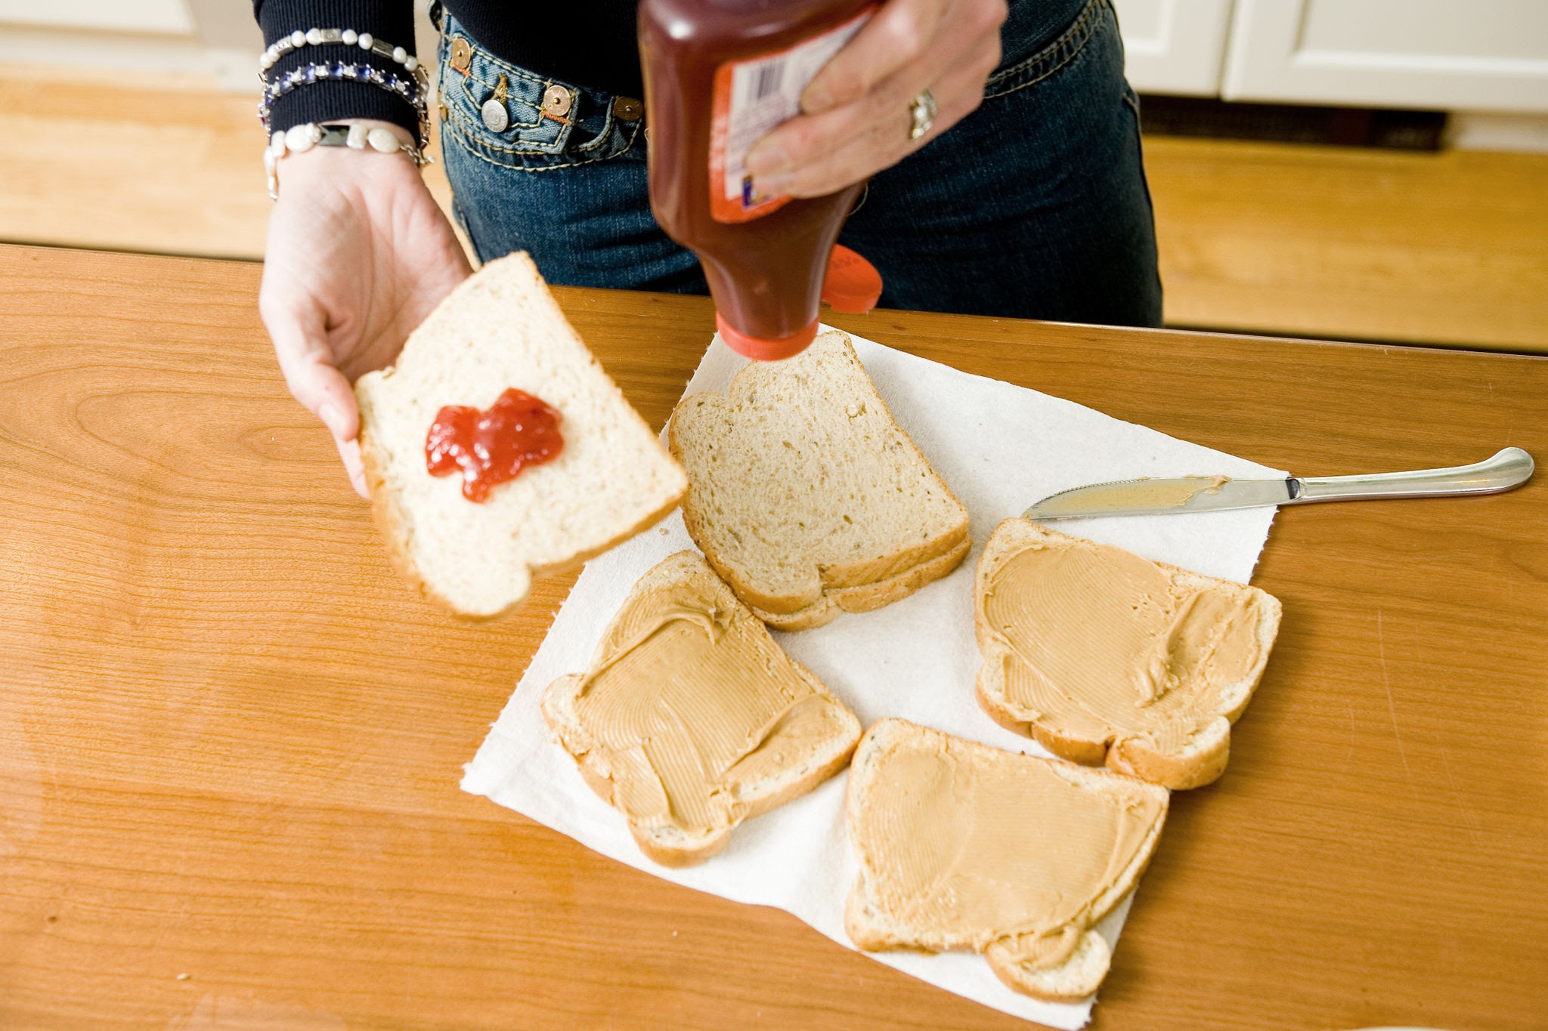
Logical Steps
Most Common Answers:
Open the bread bag
Take out two slices
Open the peanut butter jar
Spread peanut butter on one slice
Open the jelly jar
Spread jelly on the other slice
Put the slices together
These instructions look complete. But watch what happens when followed exactly...
September 28th, 2025
BHCC CSC 125-03

Slide 6
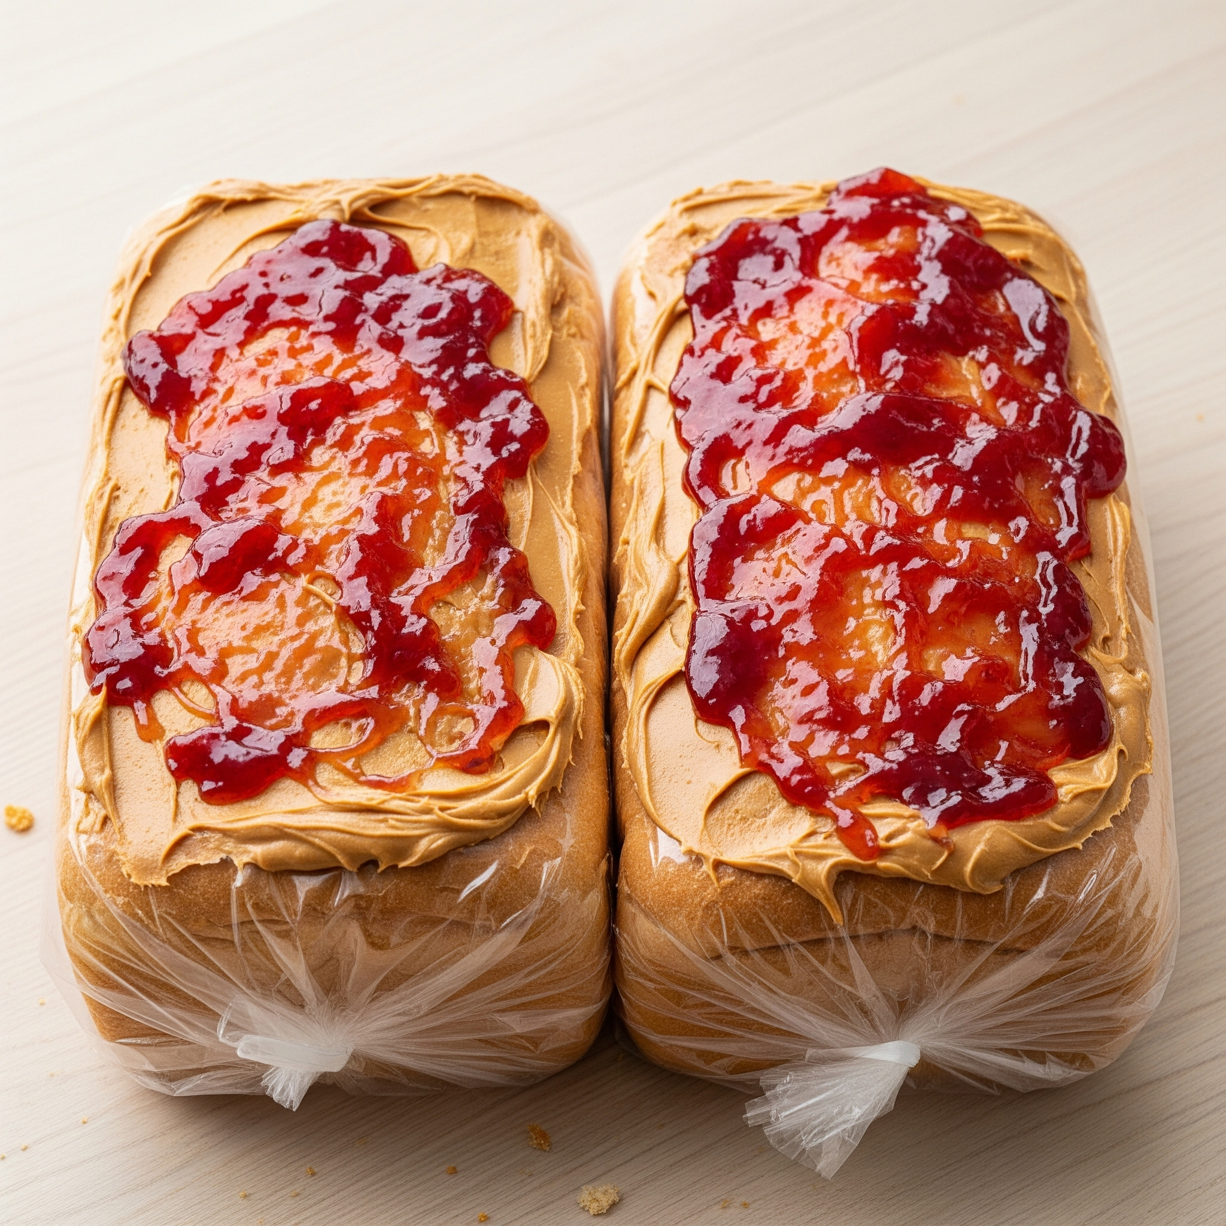
The Bread Bag
If you forgot to tell the computer to open the bag first, it tries to spread peanut butter on bread that's still inside the sealed bag.
If the bag was already open, the computer rips the bread trying to "open" it anyway.
If the bag was empty the computer starts spreading pb&j all over your counter
If the bread is moldy you continue with the process
September 28th, 2025
BHCC CSC 125-03

Slide 7
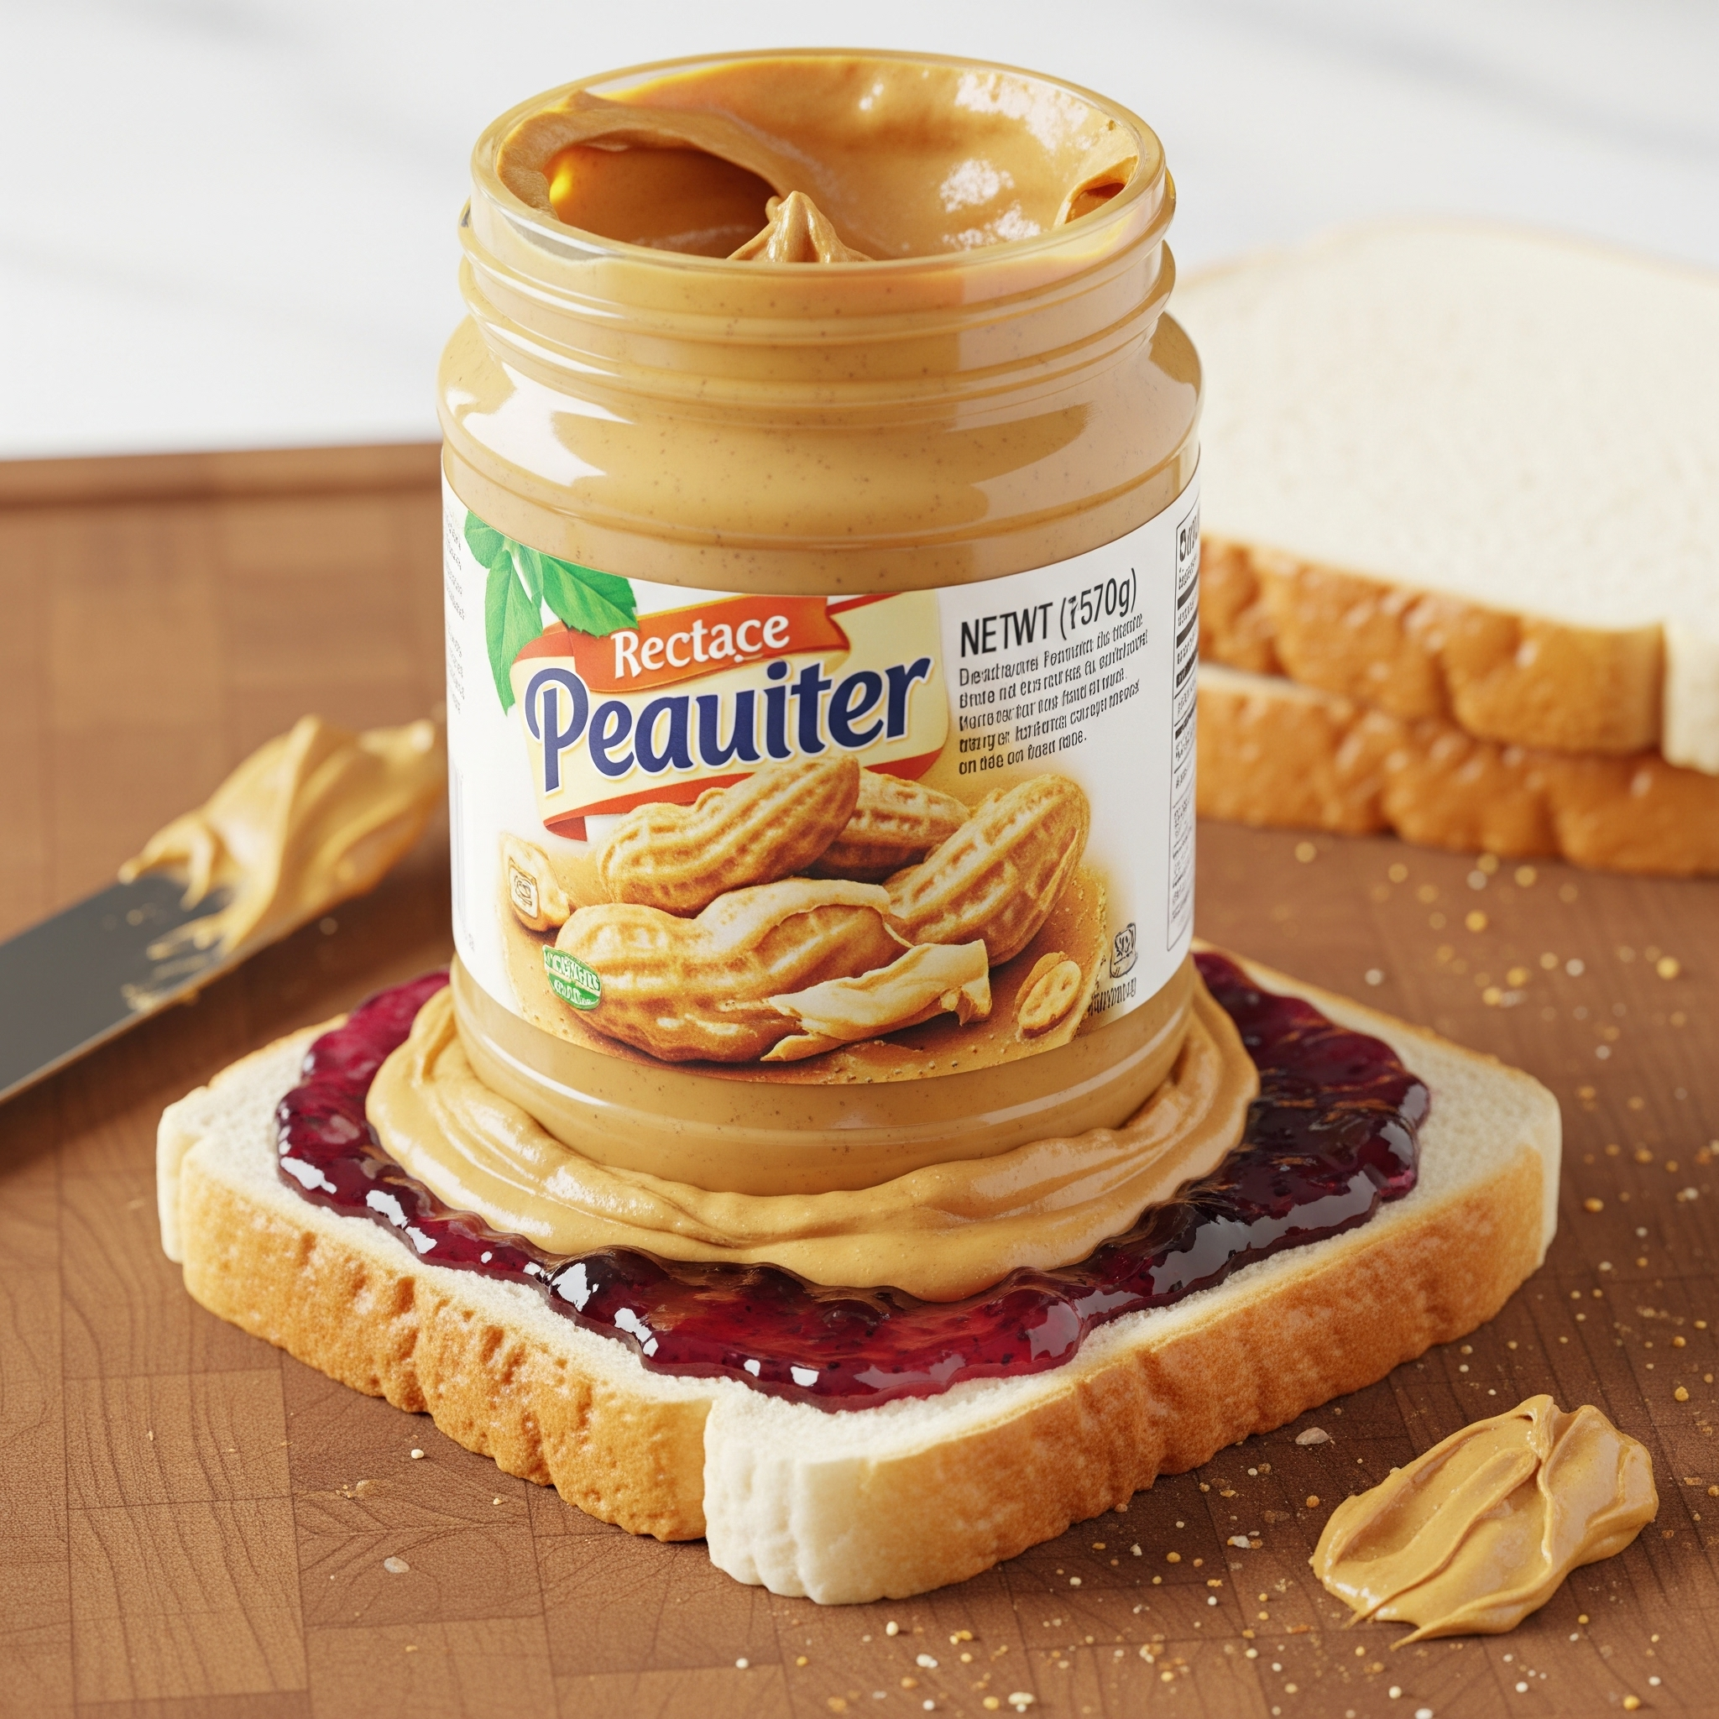
Spreading Peanut Butter
Similarly, what if you forgot to open the jar first? The computer tries to spread a closed jar across the bread.
What if the jar was already open but empty? The computer scrapes an empty jar against the bread, accomplishing nothing.
Did you check for allergies????
The instructions assumed a specific starting state, but reality is unpredictable. The bread bag might be open or sealed. The jar might be closed, open, or empty. These instructions only work in ONE perfect scenario.
September 28th, 2025
BHCC CSC 125-03

Slide 8
The Solution? Conditionals
Complete instructions that check conditions:
IF bread bag is sealed, THEN open it
Take out two slices of bread
IF peanut butter jar is closed, THEN open it
IF jar has peanut butter, THEN spread on one slice, ELSE get new jar from pantry
IF jelly jar is closed, THEN open it
IF jar has jelly, THEN spread on other slice, ELSE get new jar
Put the two slices together
Now the instructions work regardless of the starting state. This is how real programs must work, checking conditions before acting, not assuming everything is perfect.
September 28th, 2025
BHCC CSC 125-03

